Slide 1

????Key word Spotting???
Students:
Ivancich Stefano
Masiero Luca
Supervisor:
Rossi Michele
22 September 2020

Slide 2
Outline
The Problem
The Solution
How we have tackled it
What we tried
Architecture 1: 1D CNN on RAW data
Architecture 2: DSConv on 80 Mels, 40 MFCC and 40MFCC+delta
Architecture 3: CNN+RNN+Attention
Performance comparison
… ??????????????????????????????????????
Conclusions
Ivancich S. - Masiero L.
22 September 2020
1

Slide 3
The Problem
Key word spotting:
Goal: detect a relatively small set of predefined keywords (10 or 21) in a stream of user utterances
Application: Mobile phone, smart home device, industrial machines
Metrics:
Accuracy
# of parameters
Prediction speed (milliseconds)
Ivancich S. - Masiero L.
22 September 2020
2

Slide 4
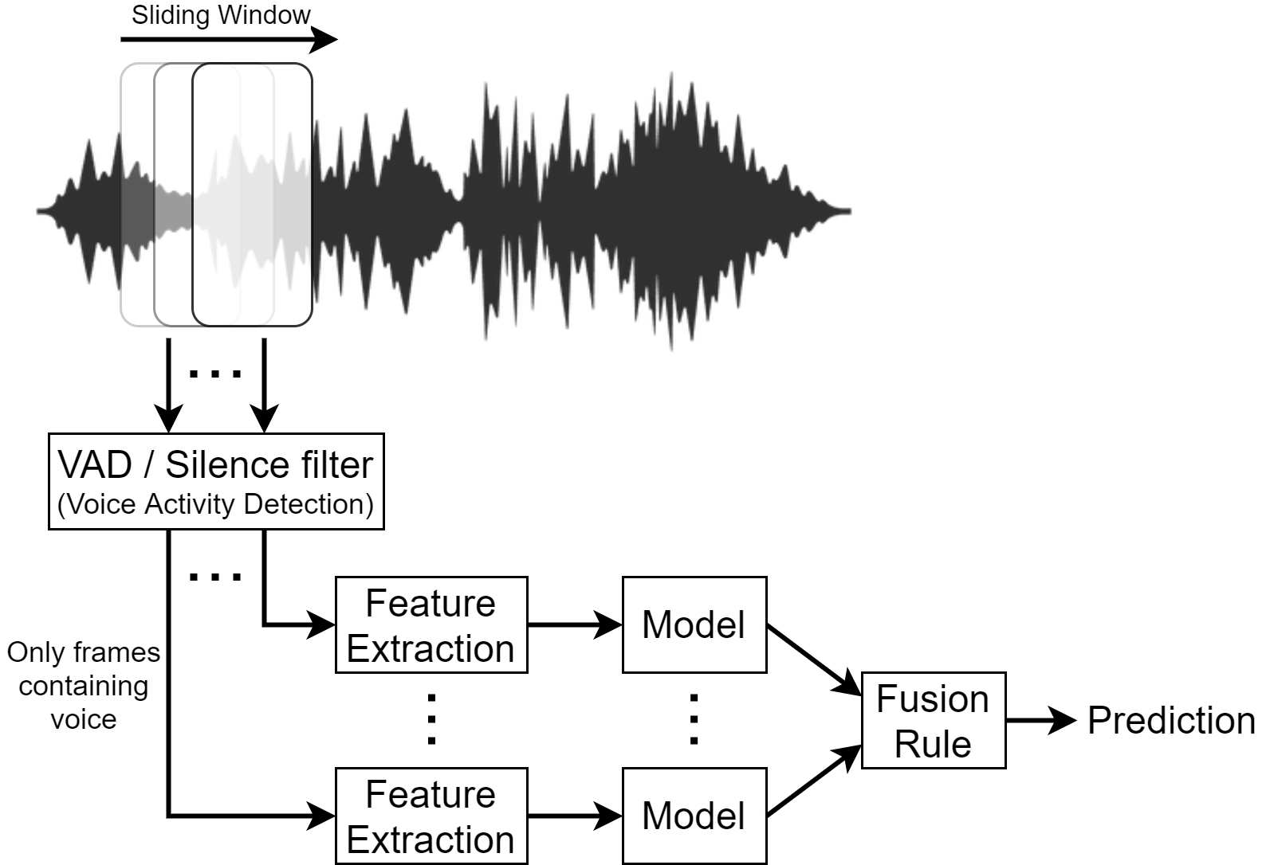
The Solution
Ivancich S. - Masiero L.
22 September 2020
2

Slide 5
How we have tackled it
1) Literature from:
Teacher’s material
ArchiveX
paperswithcode.com
Reddit
GitHub
Paper’s references
2) For each paper:
What we find useful for our problem?
Which references we want to follow?
1D CNN
Attention
40 MFCC
DSConv
…
Ivancich S. - Masiero L.
20 July 2020
3

Slide 6

How we have tackled it
3) Try to mix from things written down
Example:
Paper X says that MFCC are good for human voice …
Paper Y says that DSConv are faster than normal CNN …
Mixing X and Y will work?
4 ) Debugging:
Bias vs Variance
Error Analysis: look at the misclassified examples
Why didn’t work? When explaining we discovered other things to try
40 MFCC
DSConv
Ivancich S. - Masiero L.
20 July 2020
4

Slide 7
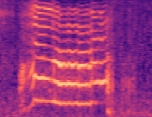
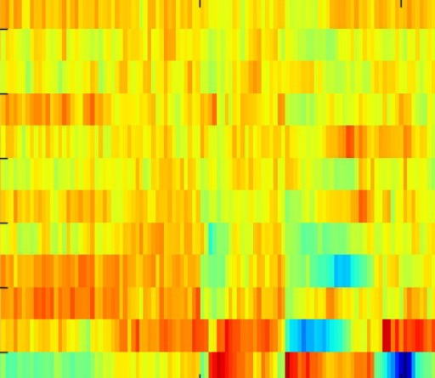
What we tried
Datasets:
10 commands
21 commands
Data Preprocessing techniques:
No preprocessing (Raw Data)
80 Mel spectogram
40 MFCC
40 MFCC + 40delta + 40deltadelta (=120)
Learning Architectures:
1D CNN on RAW data
DSConv
CNN + RNN +Attention
Ivancich S. – Masiero L.
22 September 2020
5

Slide 8
What we tried
Datasets:
10 commands
21 commands
Data Preprocessing techniques:
No preprocessing (Raw Data)
80 Mel coefficients
40 MFCC
40 MFCC + 40delta + 40deltadelta (=120)
Learning Architectures:
1D CNN on RAW data
DSConv
CNN + RNN +Attention
Ivancich S. – Masiero L.
22 September 2020
5

Slide 9
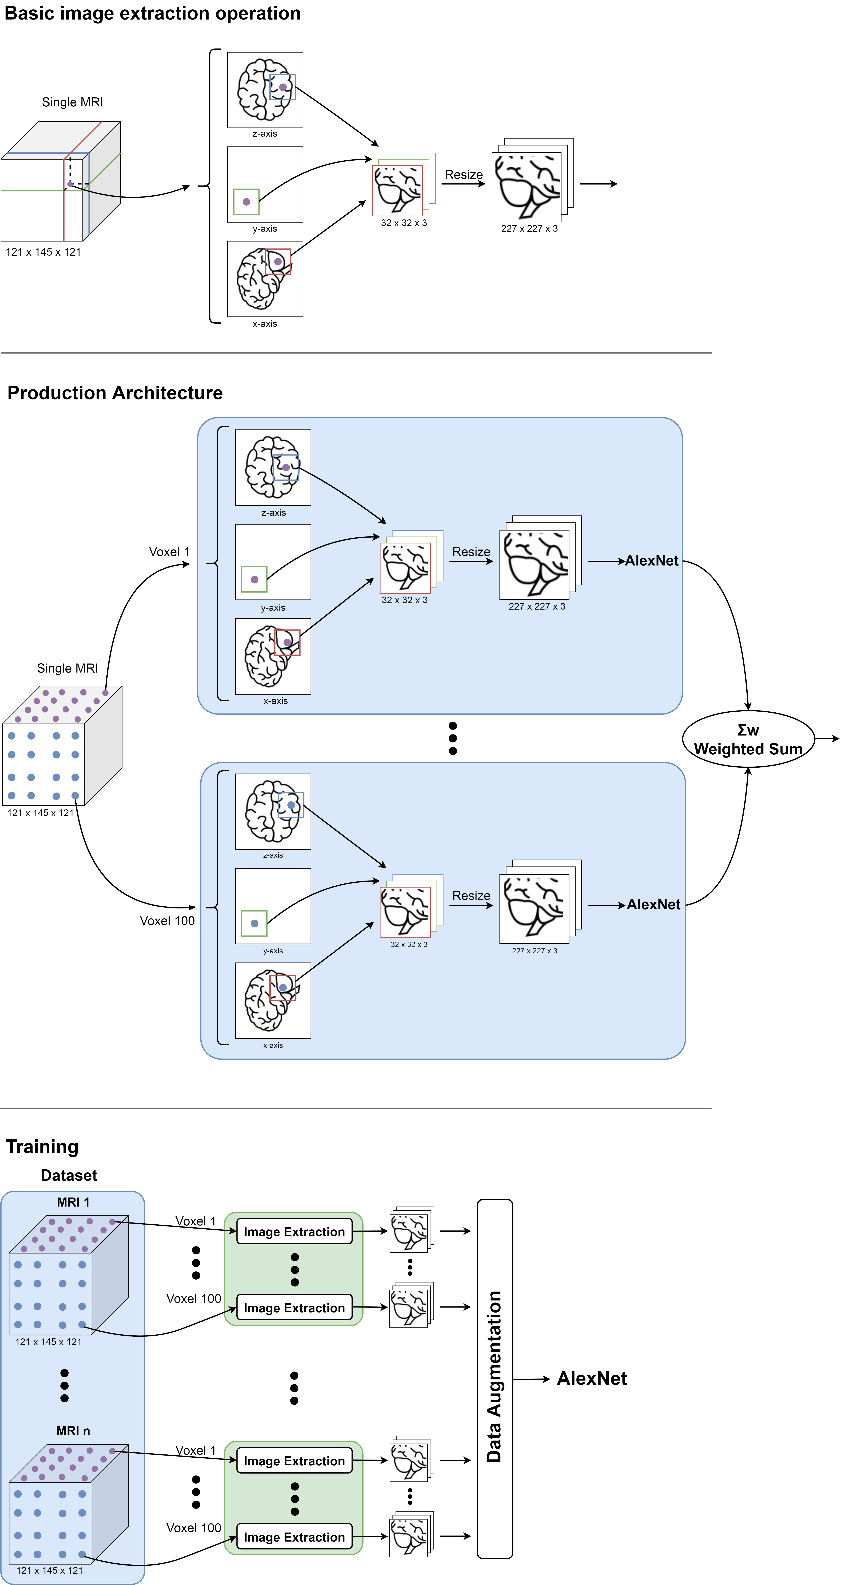
Image Extraction
MRI are 3D so to make them 2D we used the following image extraction operation: for a given voxel point, three patches of MRI 32x32 are extracted from the three planes, concatenated into a three-channel picture and resized in order to match the input size of the neural network.
Ivancich Stefano
15 July 2019
5

Slide 10
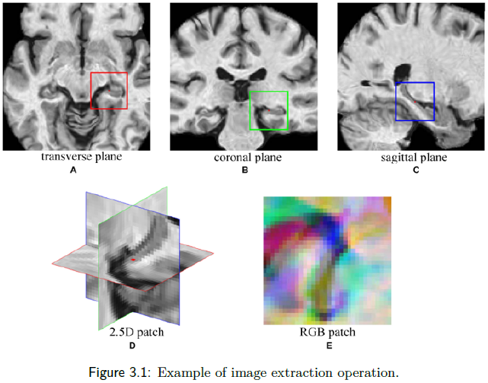
Example
Ivancich Stefano
15 July 2019
6

Slide 11
Production Architecture
Ivancich Stefano
15 July 2019
7

Slide 12
Training Architecture
Extract 100 pictures from each MRI
Perform some data augmentation
Fed them into AlexNet
Ivancich Stefano
15 July 2019
8

Slide 13
Architecture
A key challenge in applying CNNs is that sufficient training data are not always available in medical images. To avoid Over/Under-fitting:
Data Augmentation: In case of medical images this often comes down to mirror flipping, small-magnitude translations, weak Gaussian blurring, brightness augmentation and shadow augmentation.
TransferLearning from AlexNet: training CNN from scratch is usually challenging owing to the limited amount of labeled medical data. A promising alternative is to fine-tune the weights of a network that was trained using a large set of labeled natural images.
Prof. Tajbakhsh, Illinois Institute of Technology: considered several medical imaging applications and investigated how the performance of CNNs trained from scratch compared with the pre-trained CNNs. Their experiments demonstrated that pretrained CNNs performed better than CNN trained from scratch.
Ivancich Stefano
15 July 2019
9

Slide 14
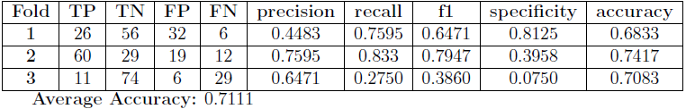
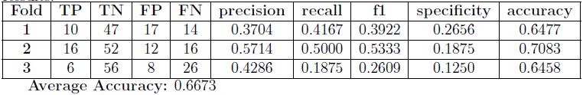
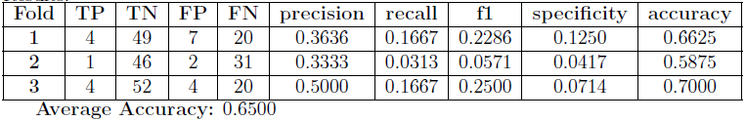
Performances
Due to the lack of memory (RAM) and computational power given to us, as we were undergraduate students: Instead of converting each MRI in 100 pictures, we have extracted only 8 pictures for each MRI, Trained on 3 folds instead of 20, haven’t performed any data augmentation. However, our supervisor will execute more exhaustive tests.
CN vs AD:
CN vs MCIc:
MCInc vs MCIc:
Ivancich Stefano
15 July 2019
10

Slide 15
Conclusions
Conclusions:
The tests showed that our model was very good at classify CN vs AD, that is an extraordinary results, because today to recognize if a person has Alzheimer different invasive medical tests must be done. With our model we need just a Magnetic Resonance.
Unfortunately CN vs MCIc and MCInc vs MCIc problems doesn’t reach good results, we think most of the problem is due to the lack of computational power.
Future Work:
Try different hyper-parameters during training
Change the structure of the network using:
pretrained VGG-19 or Inception v4
3D-Convolution
Ivancich Stefano
15 July 2019
11

Slide 16
Thank You
Thanks for your attention!
Any questions?
Ivancich S. - Masiero L.
20 July 2020
12

